Slide 1
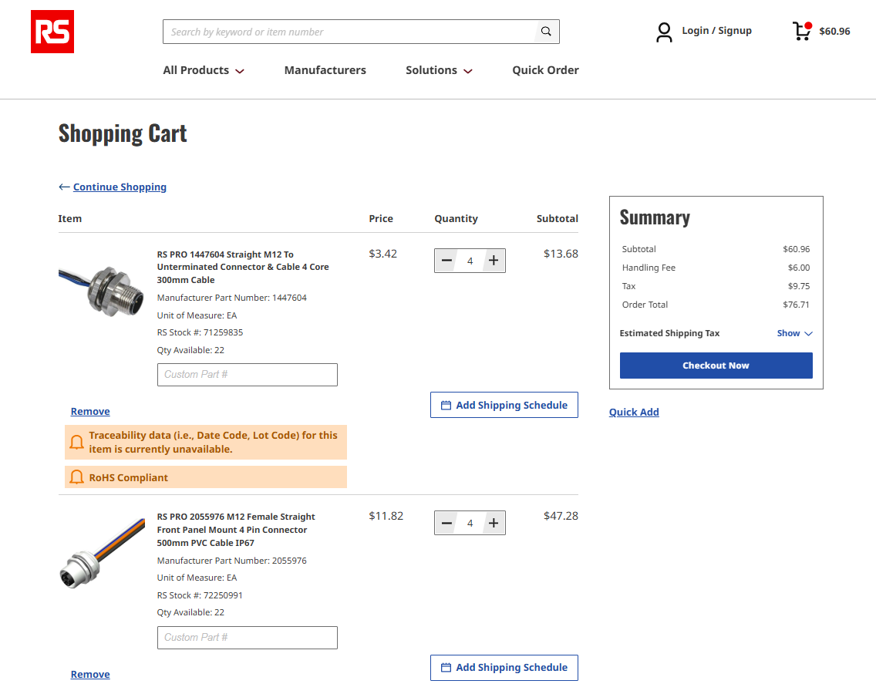
RS-online.com
(Power connectors between sign and battery box)

Slide 2
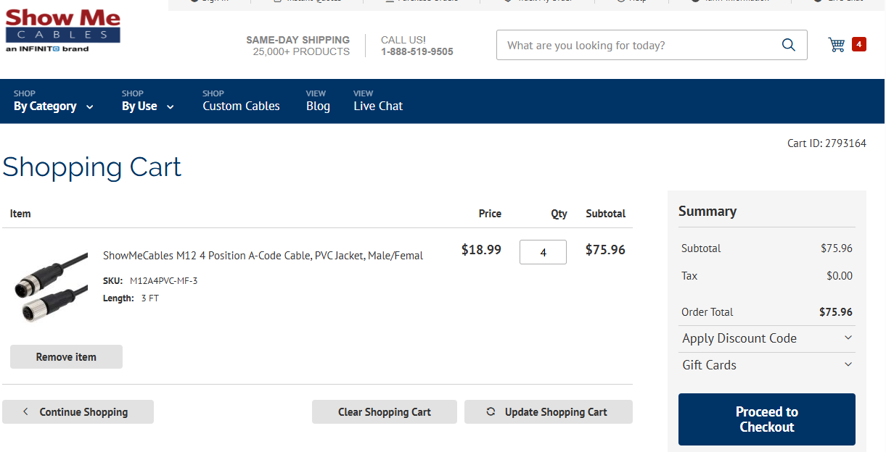

Slide 3
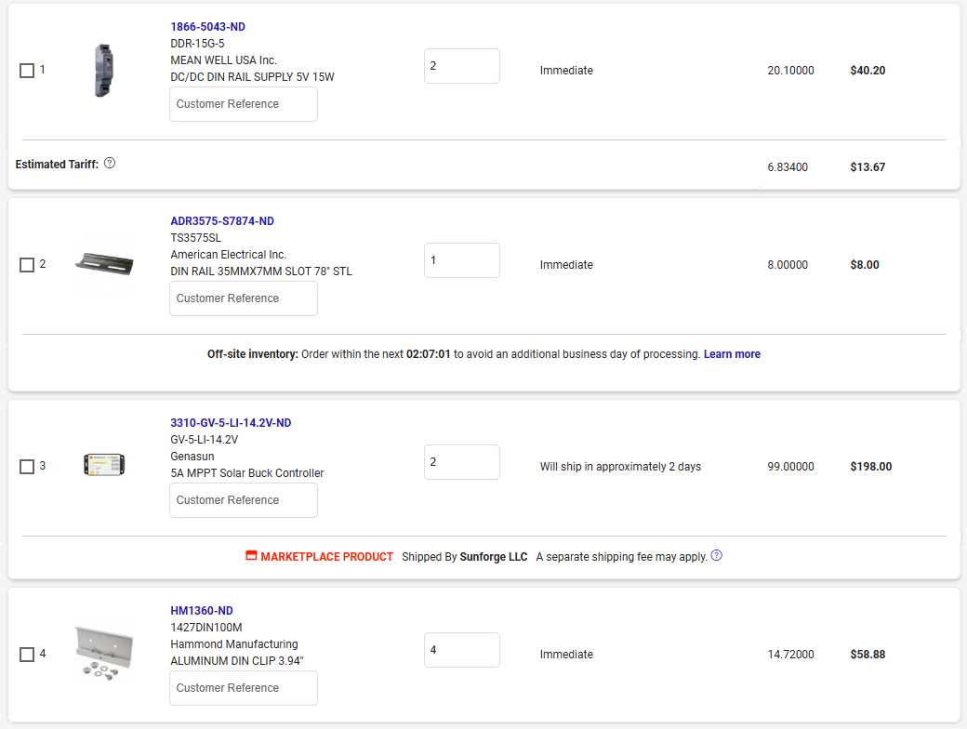
Digikey

